Slide 1
Learning Objective
I will be able to review integration, DRV, Bernoulli and Binomial Distributions
Success Criteria
At the end of the lesson, I will be able to:
Review concepts on integration, DRV, Bernoulli and Binomial Distributions

Slide 2

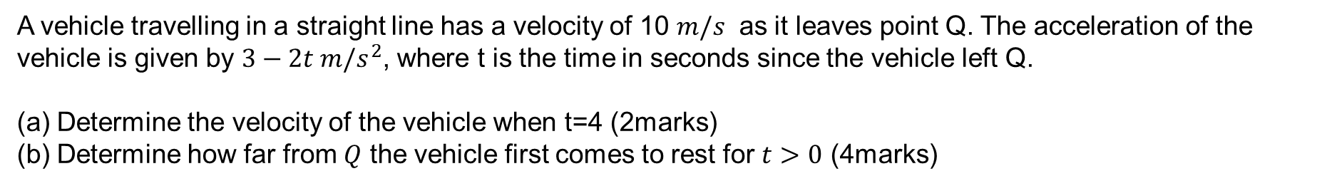
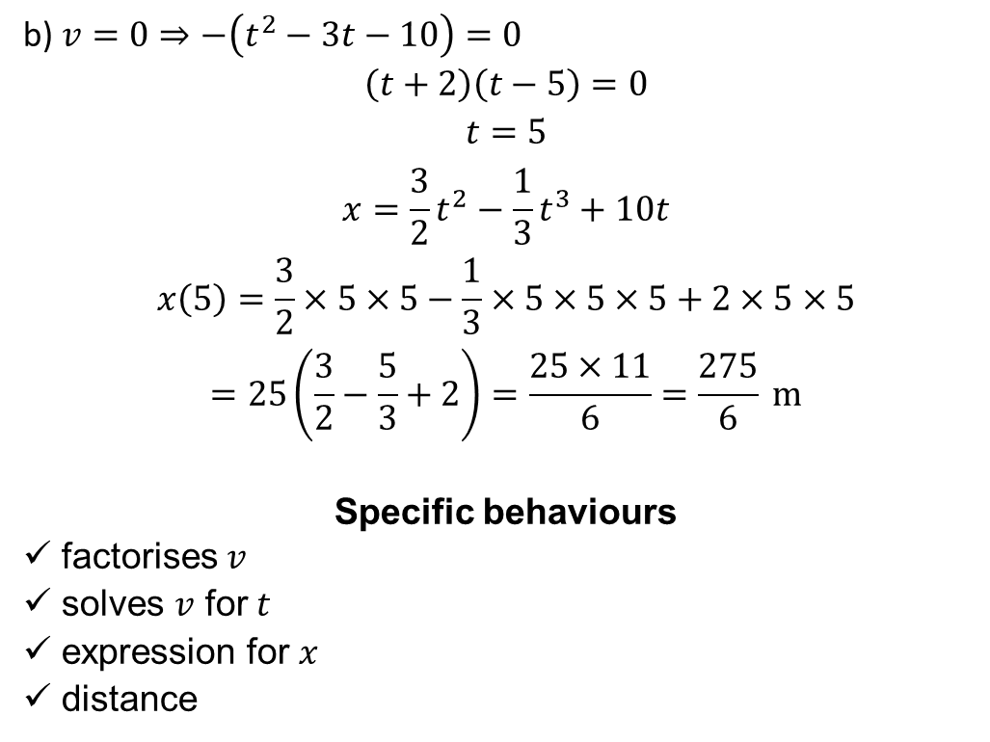
2019 ATAR Calc Free Q7 (6marks)
A vehicle travelling in a straight line has a velocity of 10 $m/s^{ }$ as it leaves point Q. The acceleration of the vehicle is given by $3−2t m/s^{2}$, where t is the time in seconds since the vehicle left Q.
Determine the velocity of the vehicle when t=4 (2marks)
Determine how far from $Q$ the vehicle first comes to rest for $t>0$ (4marks)
b) $v=0⇒−\left(t^{2}−3t−10\right)=0$
$$\left(t+2\right)\left(t−5\right)=0$$
$$t=5$$
$$x=\frac{3}{2}t^{2}−\frac{1}{3}t^{3}+10t$$
$$x\left(5\right)=\frac{3}{2}×5×5−\frac{1}{3}×5×5×5+2×5×5$$
$$=25\left(\frac{3}{2}−\frac{5}{3}+2\right)=\frac{25×11}{6}=\frac{275}{6} \text{m}$$
Specific behaviours
✓ factorises $v$
ü solves $v$ for $t$
ü expression for $x$
ü distance
a) $v=3t−t^{2}+10$
$$v\left(4\right)=12−16+10=6 \text{m}\text{/}\text{s}$$
Specific behaviours
✓ expression for $v$
ü $v(4)$

Slide 3

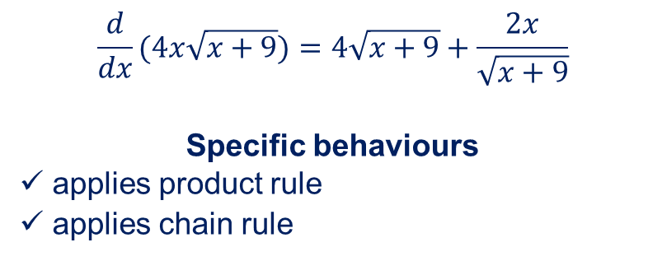
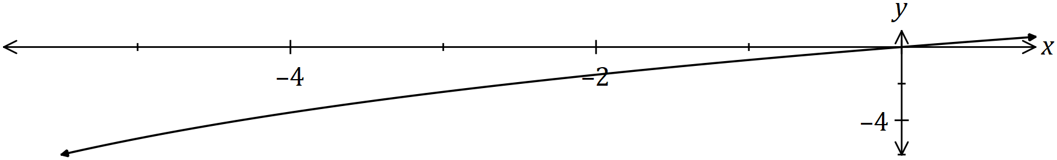
2019 ATAR Calc Free Q8 (7marks)
Determine $\begin{matrix}d \\ \overline{dx}\end{matrix}\left(4x\sqrt{x+9}\right)$ (2 marks)
Part of the graph of $y=\begin{matrix}2x \\ \overline{\sqrt{x+9}}\end{matrix}$ is shown below Using your answer from part (a) or otherwise, determine $\int_{−5}^{0}{\underset{ }{\overset{ }{\begin{matrix}2x \\ \overline{\sqrt{x+9}}\end{matrix}}}}dx$.
$$\frac{d}{dx}(4x\sqrt{x+9})=4\sqrt{x+9}+\frac{2x}{\sqrt{x+9}}$$
Specific behaviours
✓ applies product rule
ü applies chain rule

Slide 4
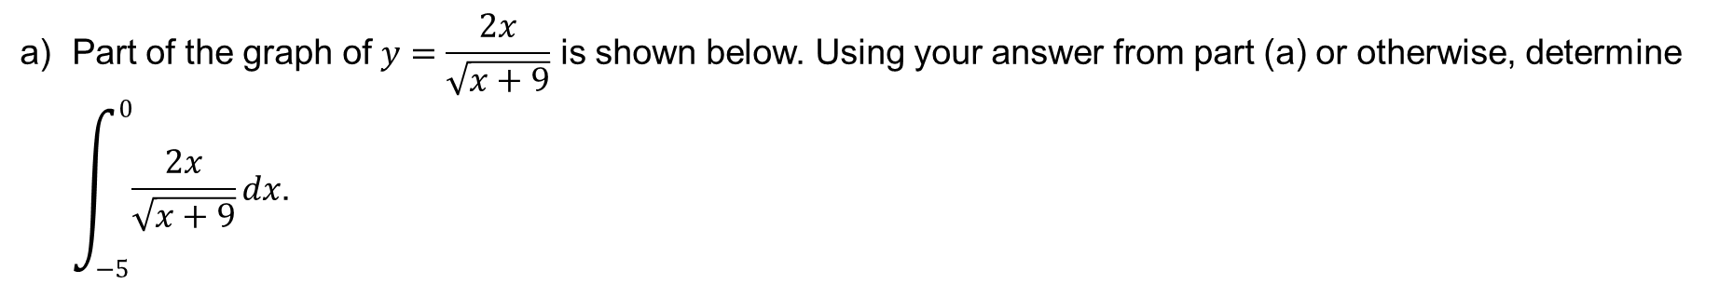
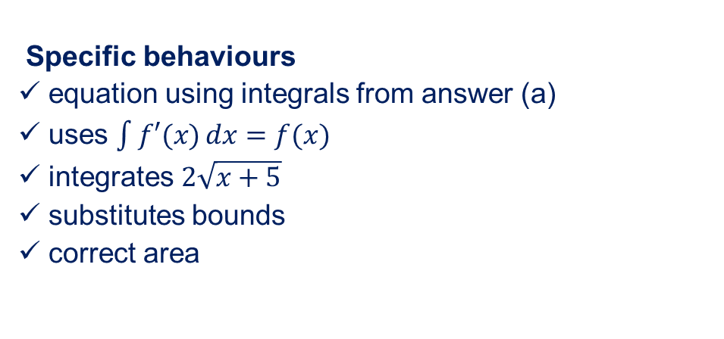
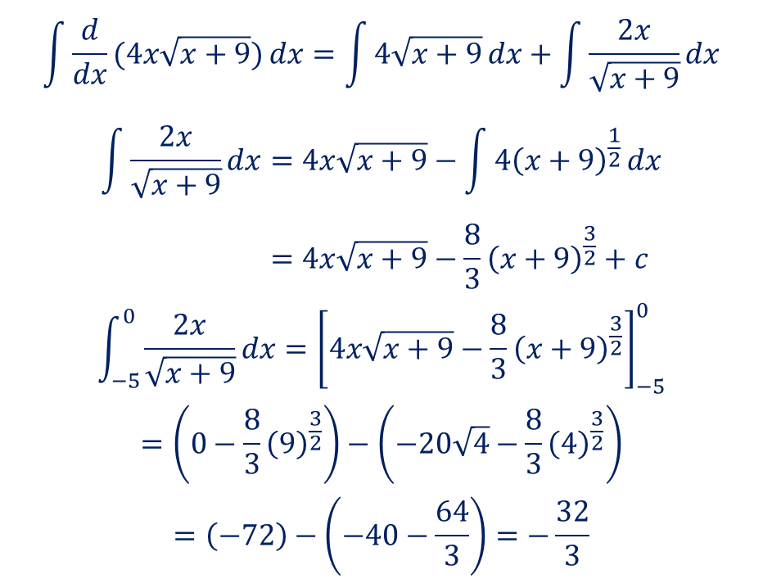
2019 ATAR Calc Free Q8 (7marks)
Part of the graph of $y=\begin{matrix}2x \\ \overline{\sqrt{x+9}}\end{matrix}$ is shown below. Using your answer from part (a) or otherwise, determine $\int_{−5}^{0}{\underset{ }{\overset{ }{\begin{matrix}2x \\ \overline{\sqrt{x+9}}\end{matrix}}}}dx$.
$$\int{\frac{d}{dx}(4x\sqrt{x+9})}dx=\int{4\sqrt{x+9}}dx+\int{\frac{2x}{\sqrt{x+9}}}dx$$
$$\int{\frac{2x}{\sqrt{x+9}}}dx=4x\sqrt{x+9}−\int{4{\left(x+9\right)}^{\frac{1}{2}}}dx \\ =4x\sqrt{x+9}−\frac{8}{3}{\left(x+9\right)}^{\frac{3}{2}}+c$$
$$\int_{−5}^{0}{\frac{2x}{\sqrt{x+9}}}dx={\left[4x\sqrt{x+9}−\frac{8}{3}{\left(x+9\right)}^{\frac{3}{2}}\right]}_{−5}^{0}$$
$$=\left(0−\frac{8}{3}{\left(9\right)}^{\frac{3}{2}}\right)−\left(−20\sqrt{4}−\frac{8}{3}{\left(4\right)}^{\frac{3}{2}}\right)$$
$$=\left(−72\right)−\left(−40−\frac{64}{3}\right)=−\frac{32}{3}$$
Specific behaviours
✓ equation using integrals from answer (a)
ü uses $\int{f′(x)}dx=f(x)$
ü integrates $2\sqrt{x+5}$
ü substitutes bounds
ü correct area

Slide 5
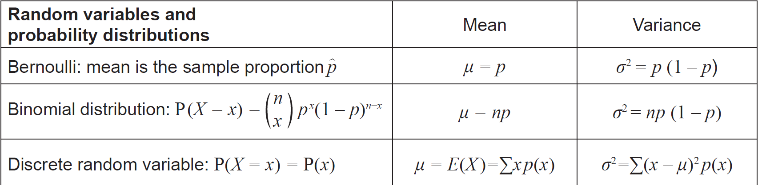
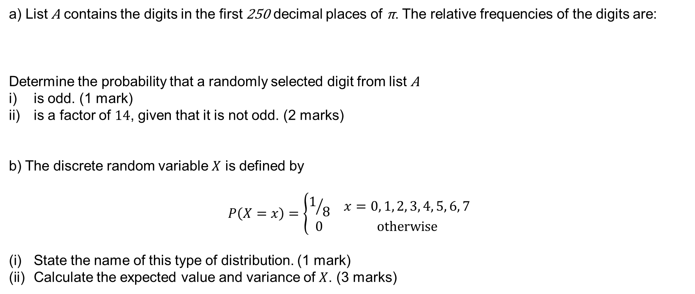
2021 ATAR Calc assumed Q11 (7marks)
a) List A contains the digits in the first 250 decimal places of π. The relative frequencies of the digits are:
Determine the probability that a randomly selected digit from list A
is odd. (1 mark)
is a factor of $14$, given that it is not odd. (2 marks)
b) The discrete random variable $X$ is defined by
$$P\left(X=x\right)=\left\{\begin{matrix}1/8 & x=0, 1, 2, 3, 4, 5, 6, 7 \\ 0 & \text{otherwise}\end{matrix}\right.$$
State the name of this type of distribution. (1 mark)
Calculate the expected value and variance of $X$. (3 marks)
Digit | $$0$$ | $$1$$ | $$2$$ | $$3$$ | $$4$$ | $$5$$ | $$6$$ | $$7$$ | $$8$$ | $$9$$
Frequency | $$0.088$$ | $$0.104$$ | $$0.116$$ | $$0.096$$ | $$0.112$$ | $$0.096$$ | $$0.088$$ | $$0.068$$ | $$0.124$$ | $$0.108$$

Slide 6
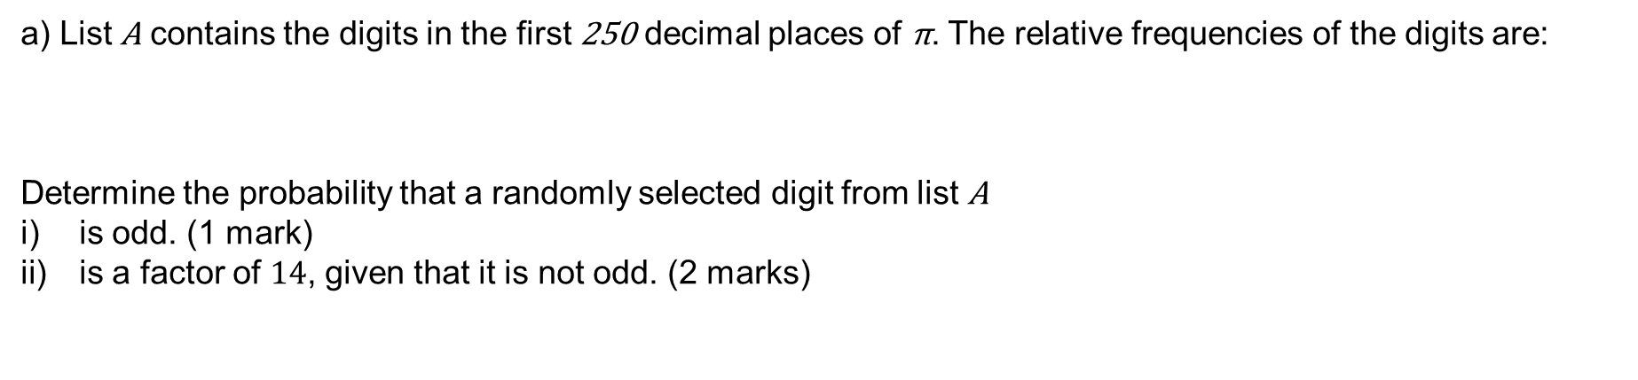
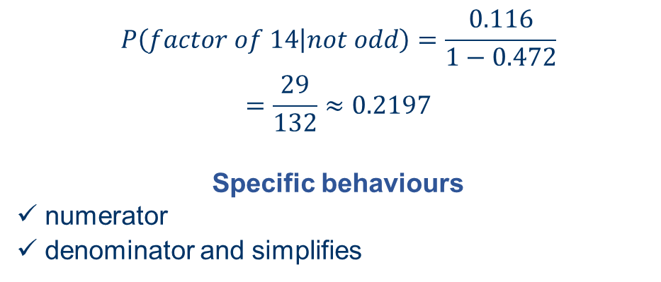
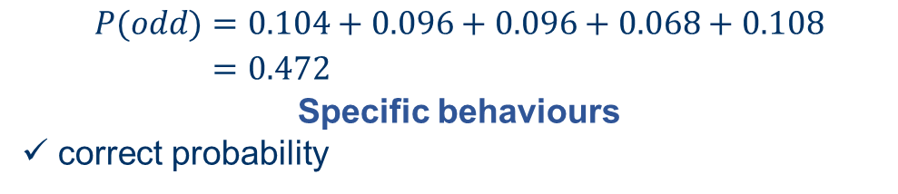
2021 ATAR Calc assumed Q11 (7marks)
a) List A contains the digits in the first 250 decimal places of π. The relative frequencies of the digits are:
Determine the probability that a randomly selected digit from list A
is odd. (1 mark)
is a factor of $14$, given that it is not odd. (2 marks)
Digit | $$0$$ | $$1$$ | $$2$$ | $$3$$ | $$4$$ | $$5$$ | $$6$$ | $$7$$ | $$8$$ | $$9$$
Frequency | $$0.088$$ | $$0.104$$ | $$0.116$$ | $$0.096$$ | $$0.112$$ | $$0.096$$ | $$0.088$$ | $$0.068$$ | $$0.124$$ | $$0.108$$
$$P(odd)=0.104+0.096+0.096+0.068+0.108 \\ =0.472$$
Specific behaviours
✓ correct probability
$$P\left(factor of 14 | not odd\right)=\frac{0.116}{1−0.472}$$
$$=\frac{29}{132}≈0.2197$$
Specific behaviours
✓ numerator
ü denominator and simplifies

Slide 7
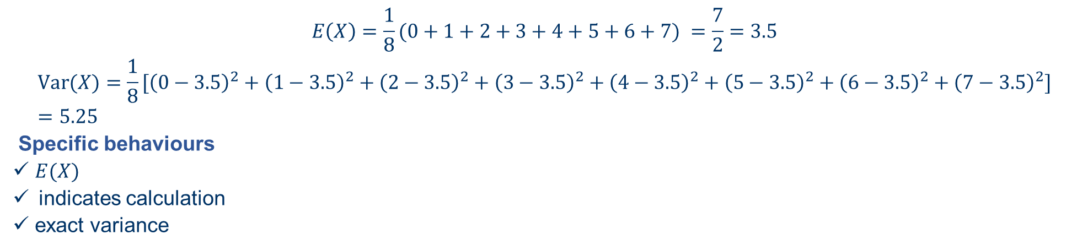
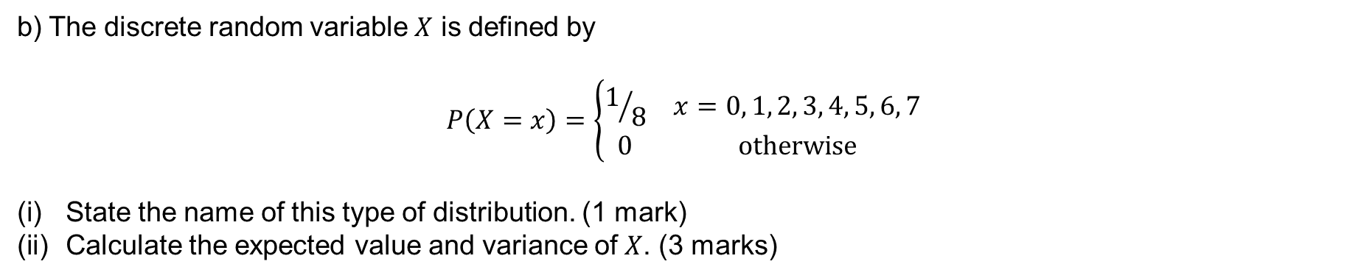
2021 ATAR Calc assumed Q11 (7marks)
b) The discrete random variable $X$ is defined by
$$P\left(X=x\right)=\left\{\begin{matrix}1/8 & x=0, 1, 2, 3, 4, 5, 6, 7 \\ 0 & \text{otherwise}\end{matrix}\right.$$
State the name of this type of distribution. (1 mark)
Calculate the expected value and variance of $X$. (3 marks)
Discrete uniform distribution
Specific behaviours
✓ states uniform distribution
$$E\left(X\right)=\frac{1}{8}(0+1+2+3+4+5+6+7) =\frac{7}{2}=3.5$$
$$\operatorname{Var}{(X)}=\frac{1}{8}[{\left(0−3.5\right)}^{2}+{\left(1−3.5\right)}^{2}+{\left(2−3.5\right)}^{2}+{\left(3−3.5\right)}^{2}+{\left(4−3.5\right)}^{2}+{\left(5−3.5\right)}^{2}+{\left(6−3.5\right)}^{2}+{\left(7−3.5\right)}^{2}] \\ =5.25$$
Specific behaviours
✓ $E(X)$
indicates calculation
ü exact variance

Slide 8
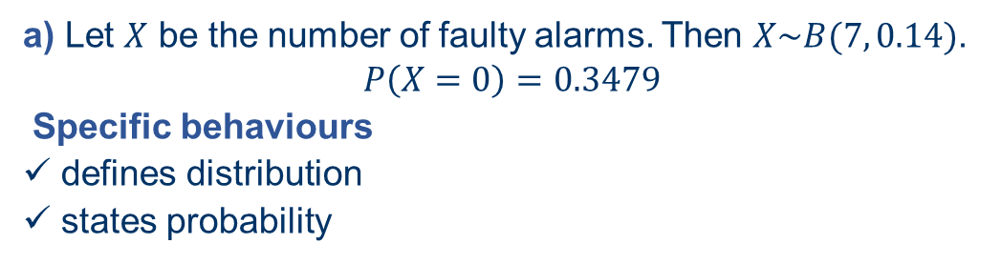
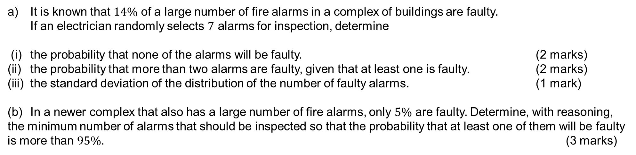
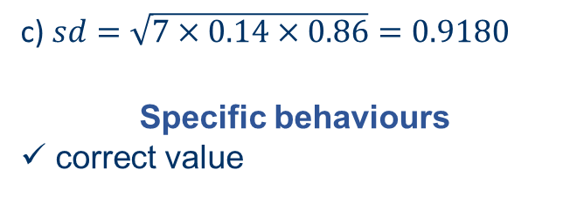
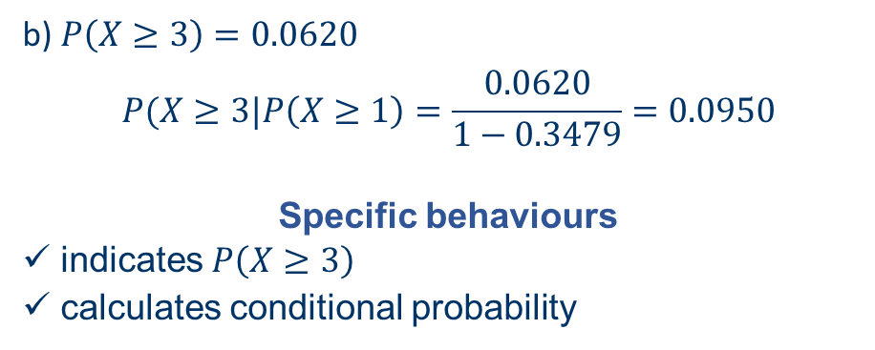
2021 ATAR Calc assumed Q15 (8 marks)
It is known that $14\%$ of a large number of fire alarms in a complex of buildings are faulty. If an electrician randomly selects $7$ alarms for inspection, determine
(i) the probability that none of the alarms will be faulty. (2 marks)
the probability that more than two alarms are faulty, given that at least one is faulty. (2 marks)
the standard deviation of the distribution of the number of faulty alarms. (1 mark)
(b) In a newer complex that also has a large number of fire alarms, only $5\%$ are faulty. Determine, with reasoning, the minimum number of alarms that should be inspected so that the probability that at least one of them will be faulty is more than $95\%$. (3 marks)
a) Let $X$ be the number of faulty alarms. Then $X\sim B(7, 0.14)$.
$$P\left(X=0\right)=0.3479$$
Specific behaviours
✓ defines distribution
ü states probability
b) $P\left(X≥3\right)=0.0620$
$$P(X≥3|P\left(X≥1\right)=\frac{0.0620}{1−0.3479}=0.0950$$
Specific behaviours
✓ indicates $P\left(X≥3\right)$
ü calculates conditional probability
c) $sd=\sqrt{7×0.14×0.86}=0.9180$
Specific behaviours
✓ correct value

Slide 9
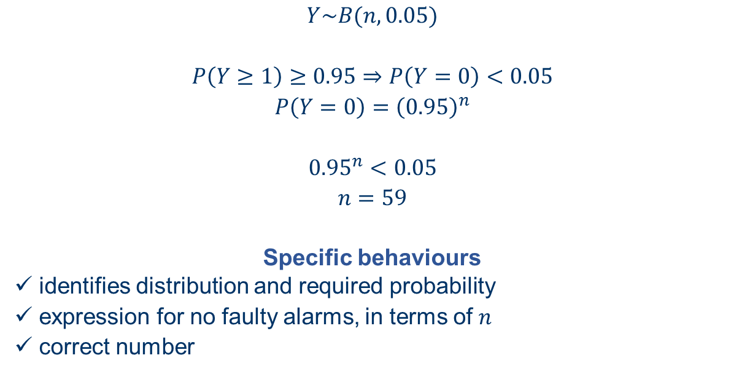
2021 ATAR Calc assumed Q15 (8 marks)
(b) In a newer complex that also has a large number of fire alarms, only $5\%$ are faulty. Determine, with reasoning, the minimum number of alarms that should be inspected so that the probability that at least one of them will be faulty is more than $95\%$. (3 marks)
$$Y\sim B(n, 0.05)$$
$$P\left(Y≥1\right)≥0.95⇒P\left(Y=0\right)<0.05$$
$$P\left(Y=0\right)={\left(0.95\right)}^{n}$$
$${0.95}^{n}<0.05$$
$$n=59$$
Specific behaviours
✓ identifies distribution and required probability
ü expression for no faulty alarms, in terms of $n$
ü correct number

Slide 10
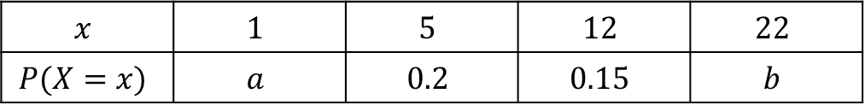
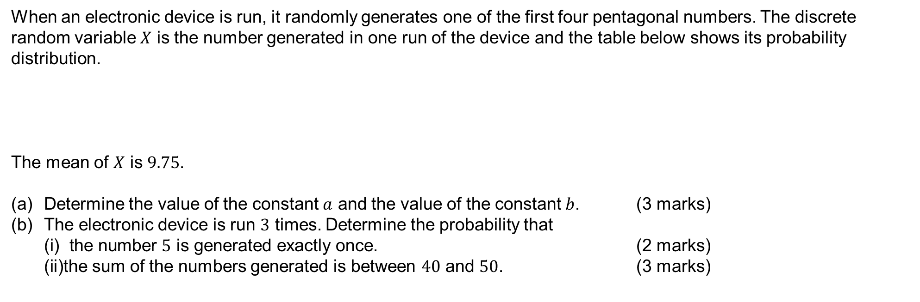
2021 ATAR Calc assumed Q18 (8 marks)
When an electronic device is run, it randomly generates one of the first four pentagonal numbers. The discrete random variable $X$ is the number generated in one run of the device and the table below shows its probability distribution.
The mean of $X$ is $9.75$.
(a) Determine the value of the constant $a$ and the value of the constant $b$. (3 marks)
(b) The electronic device is run $3$ times. Determine the probability that
(i) the number $5$ is generated exactly once. (2 marks)
(ii) the sum of the numbers generated is between $40$ and $50$. (3 marks)
$$x$$ | $$1$$ | $$5$$ | $$12$$ | $$22$$
$$P(X=x)$$ | $$a$$ | $$0.2$$ | $$0.15$$ | $$b$$

Slide 11
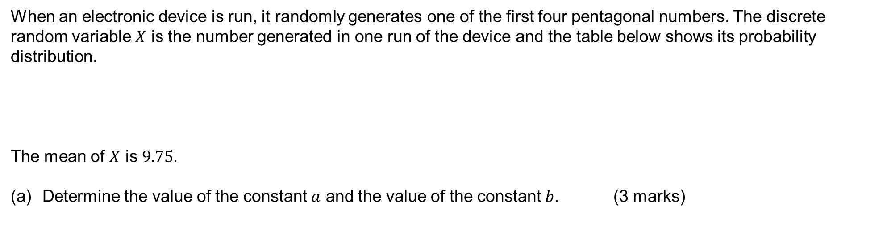
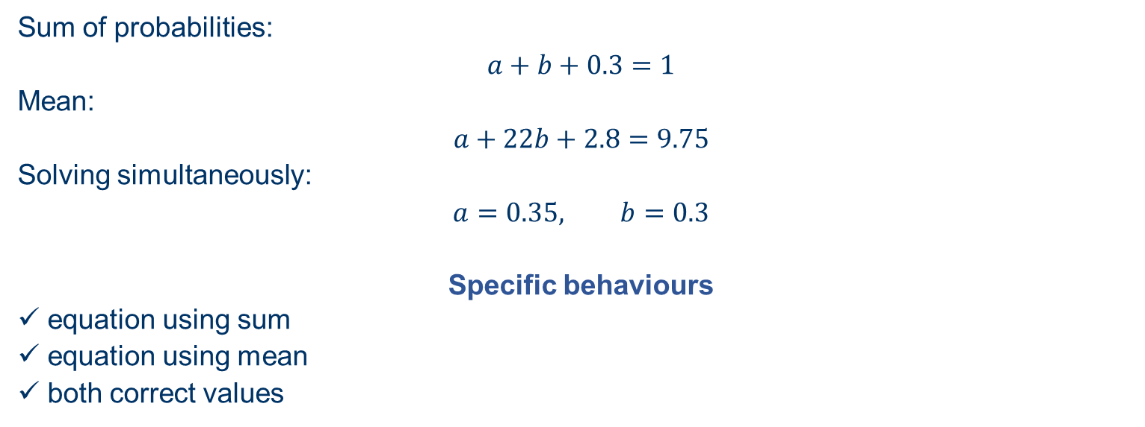
2021 ATAR Calc assumed Q18 (8 marks)
When an electronic device is run, it randomly generates one of the first four pentagonal numbers. The discrete random variable $X$ is the number generated in one run of the device and the table below shows its probability distribution.
The mean of $X$ is $9.75$.
(a) Determine the value of the constant $a$ and the value of the constant $b$. (3 marks)
$$x$$ | $$1$$ | $$5$$ | $$12$$ | $$22$$
$$P(X=x)$$ | $$a$$ | $$0.2$$ | $$0.15$$ | $$b$$
Sum of probabilities:
$$a+b+0.3=1$$
Mean:
$$a+22b+2.8=9.75$$
Solving simultaneously:
$$a=0.35, b=0.3$$
Specific behaviours
✓ equation using sum
ü equation using mean
ü both correct values

Slide 12
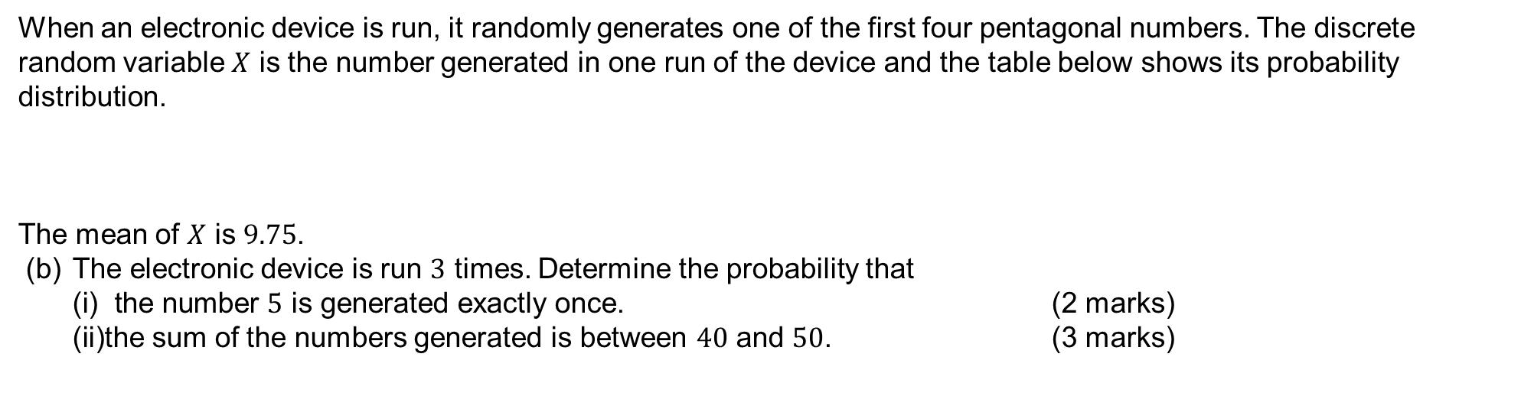
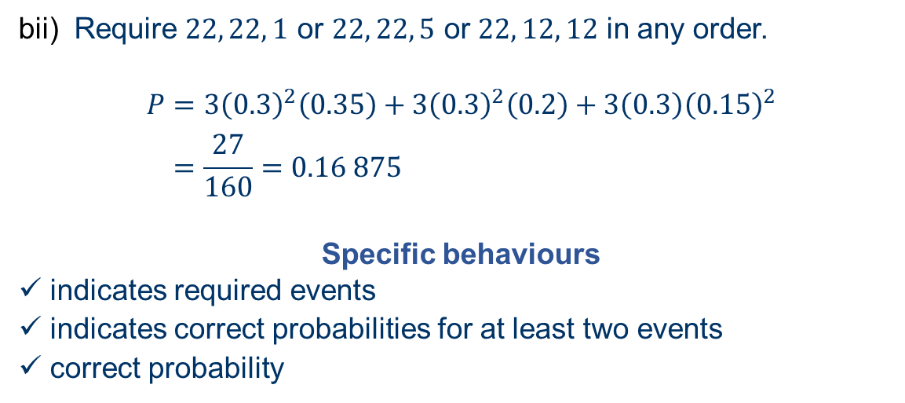
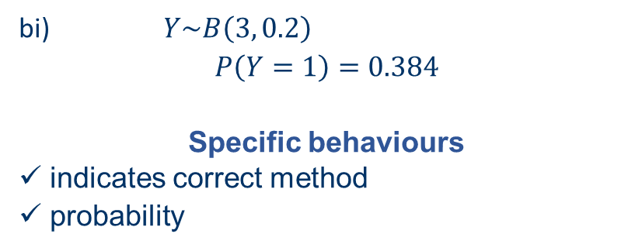
2021 ATAR Calc assumed Q18 (8 marks)
When an electronic device is run, it randomly generates one of the first four pentagonal numbers. The discrete random variable $X$ is the number generated in one run of the device and the table below shows its probability distribution.
The mean of $X$ is $9.75$.
(b) The electronic device is run $3$ times. Determine the probability that
(i) the number $5$ is generated exactly once. (2 marks)
(ii) the sum of the numbers generated is between $40$ and $50$. (3 marks)
$$x$$ | $$1$$ | $$5$$ | $$12$$ | $$22$$
$$P(X=x)$$ | $$a$$ | $$0.2$$ | $$0.15$$ | $$b$$
bi) $Y\sim B\left(3, 0.2\right)$
$$P\left(Y=1\right)=0.384$$
Specific behaviours
✓ indicates correct method
ü probability
bii) Require $22, 22, 1$ or $22, 22, 5$ or $22, 12, 12$ in any order.
$$P=3{\left(0.3\right)}^{2}\left(0.35\right)+3{\left(0.3\right)}^{2}\left(0.2\right)+3\left(0.3\right){\left(0.15\right)}^{2} \\ =\frac{27}{160}=0.16 875$$
Specific behaviours
✓ indicates required events
ü indicates correct probabilities for at least two events
ü correct probability

Slide 13
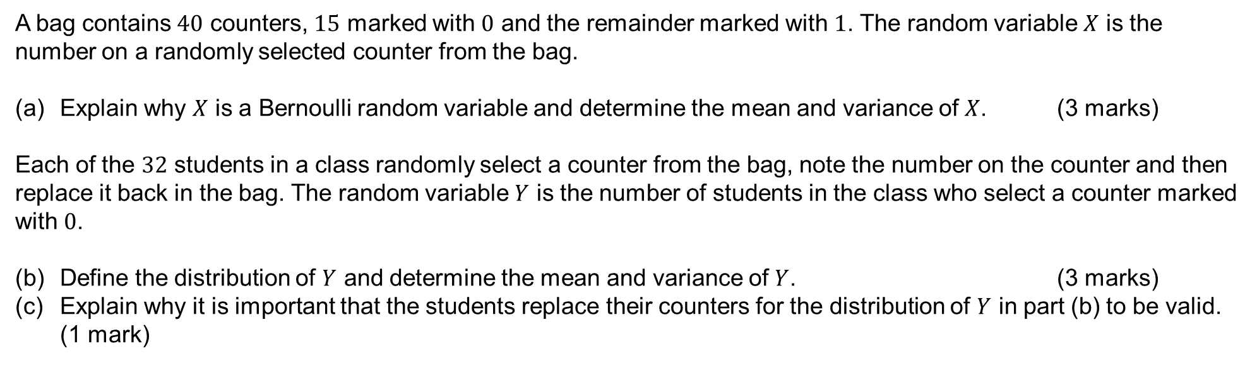
2020 ATAR Calc free Q4 (7 marks)
A bag contains $40$ counters, $15$ marked with $0$ and the remainder marked with $1$. The random variable $X$ is the number on a randomly selected counter from the bag.
(a) Explain why $X$ is a Bernoulli random variable and determine the mean and variance of $X$. (3 marks)
Each of the $32$ students in a class randomly select a counter from the bag, note the number on the counter and then replace it back in the bag. The random variable $Y$ is the number of students in the class who select a counter marked with $0$.
(b) Define the distribution of $Y$ and determine the mean and variance of $Y$. (3 marks)
(c) Explain why it is important that the students replace their counters for the distribution of $Y$ in part (b) to be valid. (1 mark)

Slide 14
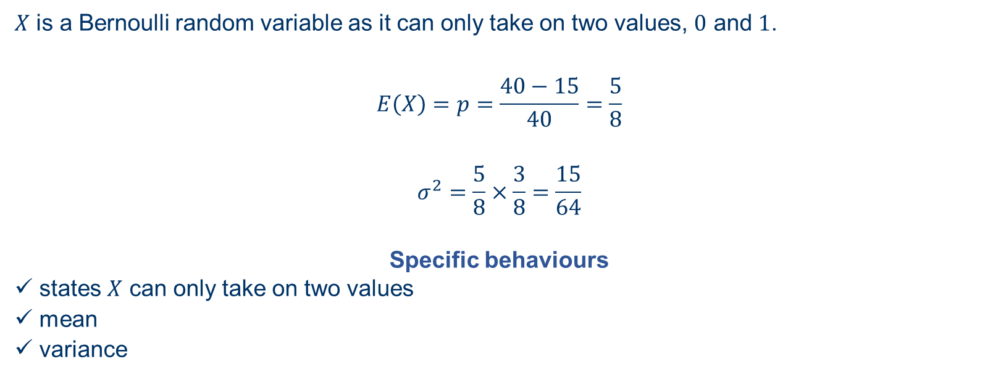
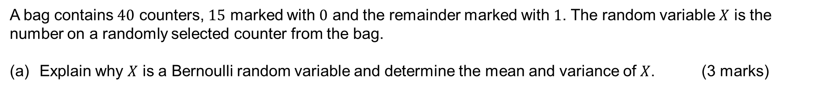
2020 ATAR Calc free Q4 (7 marks)
A bag contains $40$ counters, $15$ marked with $0$ and the remainder marked with $1$. The random variable $X$ is the number on a randomly selected counter from the bag.
(a) Explain why $X$ is a Bernoulli random variable and determine the mean and variance of $X$. (3 marks)
$X$ is a Bernoulli random variable as it can only take on two values, $0$ and $1$.
$$E\left(X\right)=p=\frac{40−15}{40}=\frac{5}{8}$$
$$σ^{2}=\frac{5}{8}×\frac{3}{8}=\frac{15}{64}$$
Specific behaviours
✓ states $X$ can only take on two values
ü mean
ü variance

Slide 15
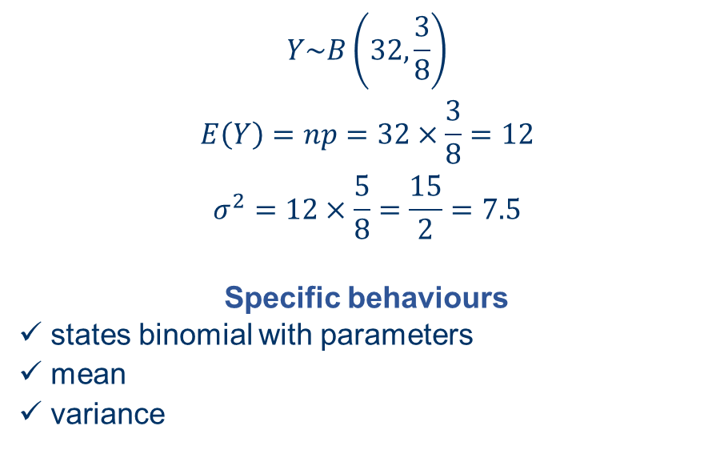
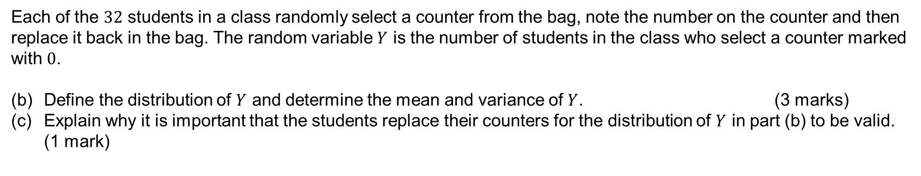
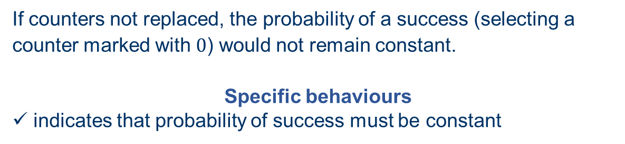
2020 ATAR Calc free Q4 (7 marks)
Each of the $32$ students in a class randomly select a counter from the bag, note the number on the counter and then replace it back in the bag. The random variable $Y$ is the number of students in the class who select a counter marked with $0$.
(b) Define the distribution of $Y$ and determine the mean and variance of $Y$. (3 marks)
(c) Explain why it is important that the students replace their counters for the distribution of $Y$ in part (b) to be valid. (1 mark)
$$Y\sim B\left(32,\frac{3}{8}\right)$$
$$E\left(Y\right)=np=32×\frac{3}{8}=12$$
$$σ^{2}=12×\frac{5}{8}=\frac{15}{2}=7.5$$
Specific behaviours
✓ states binomial with parameters
ü mean
ü variance
If counters not replaced, the probability of a success (selecting a counter marked with $0$) would not remain constant.
Specific behaviours
✓ indicates that probability of success must be constant

